Slide 1
Piece of Eden rentals
Rachel Cohen, Eric forte, Nick keckeisen Stephen masterson, Matthew walker

Slide 2
Our web application
A rental service for beachfront vacation properties
Renters → find properties for vacation
Home owners → list your beachfront property for added income
Main Functions
Create a user profile
Upload a property
Search for and view a property
Rent the property
View a property on Google Maps interface

Slide 3
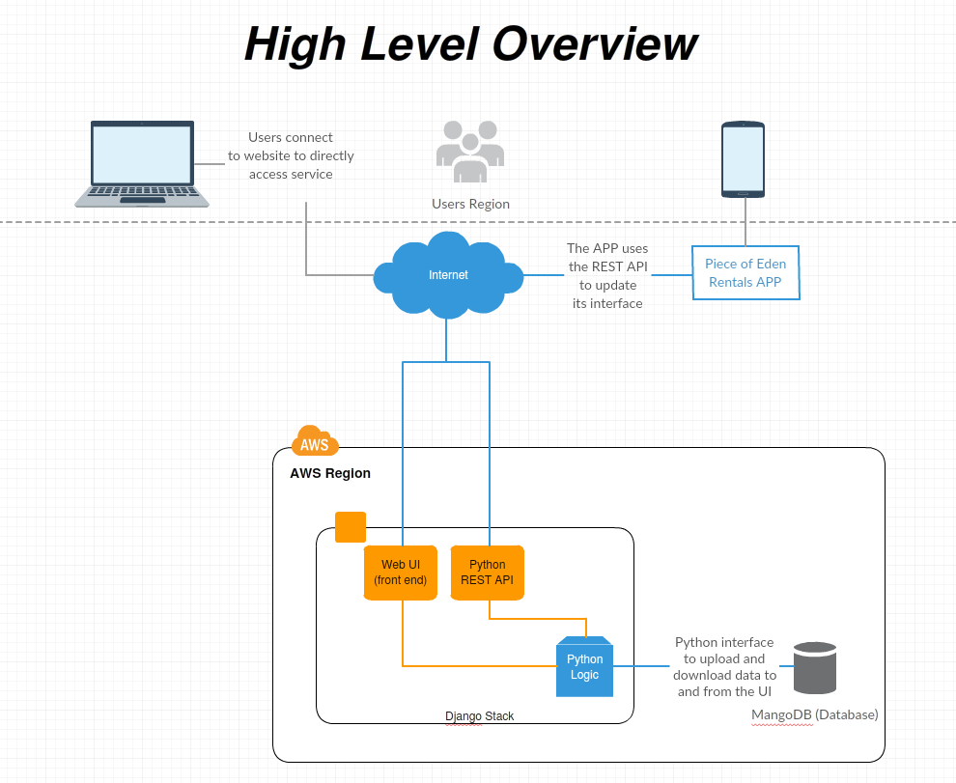

Slide 4
Design technologies
Amazon Web services for easy and reliable website hosting
Django web framework using Python for a clean & pragmatic design
Python REST API
MangoDB for data storage & retrieval

Slide 5
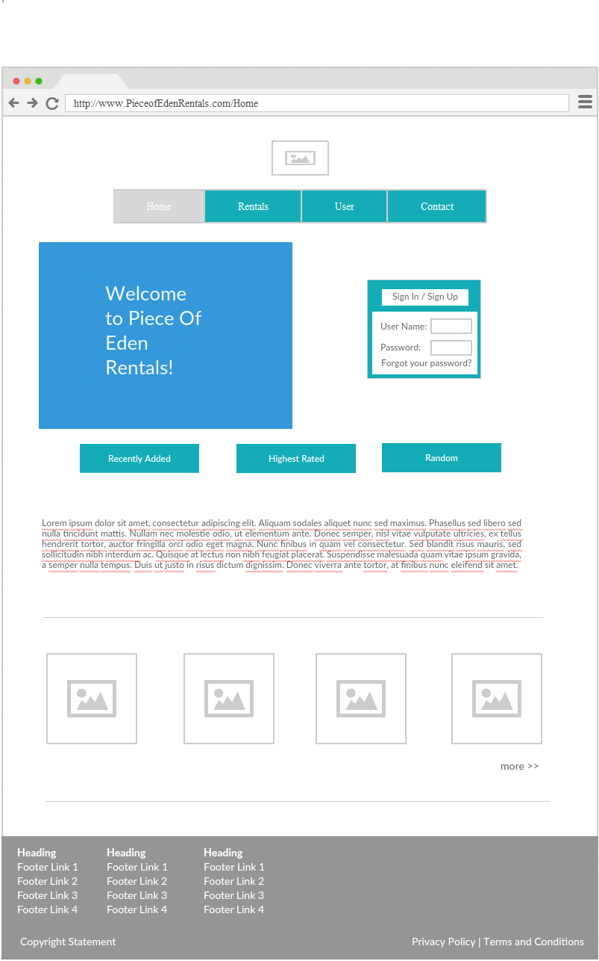
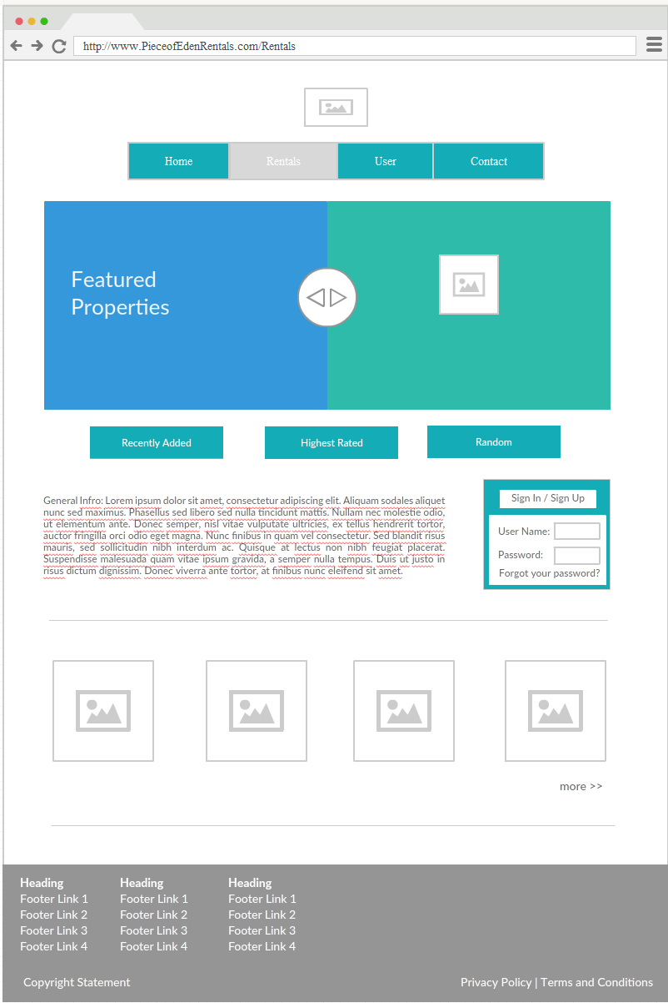
Home & Rental pages

Slide 6
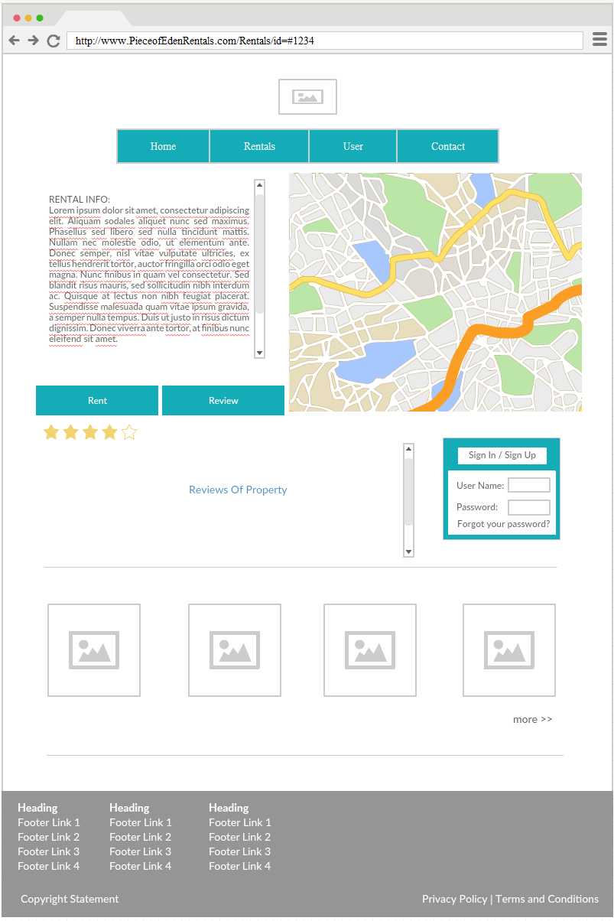
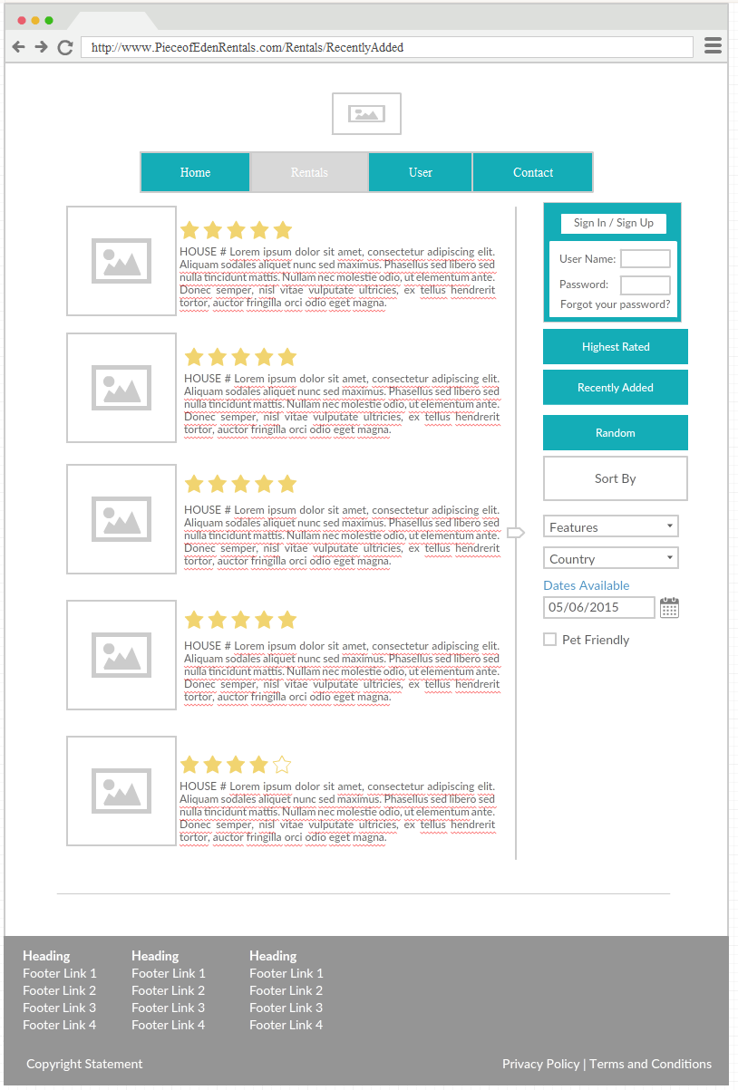
Search & Maps pages

Slide 7
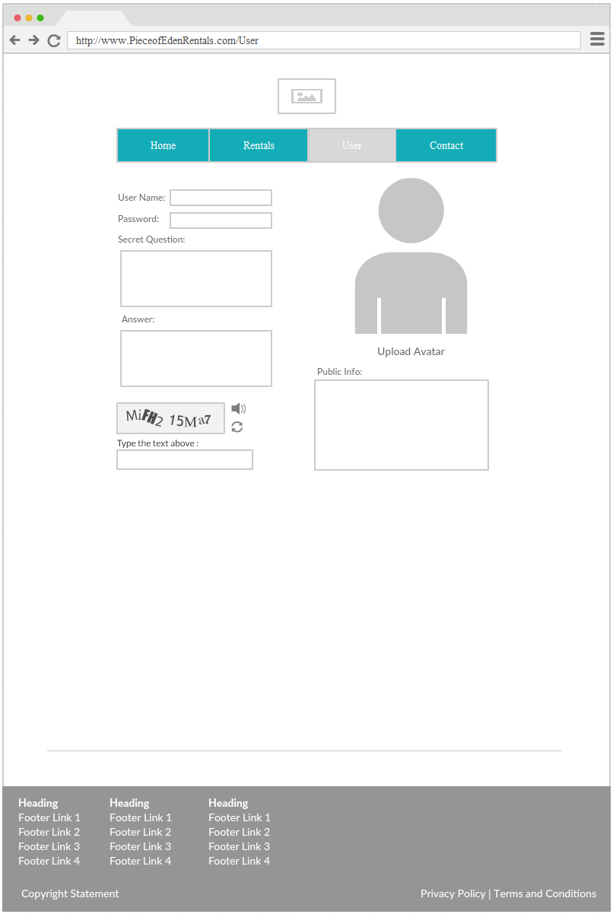
User Page

